Slide 1

Business Idea (Pitch Deck)
Khudmukhtar Pakistan Consulting Service(KPCS)
Presented by:
Jaweria Asif(9442)
Javeria Hassan(9517)
Raheel Dastagir(9334)
http://www.free-powerpoint-templates-design.com

Slide 2
DISCUSSION
01
Problem Background
Financial crises, fighting with hunger, unemployment, poverty and inflation
02
Solution
Freelancing, creative ideas implementation, blogging, content writing, innovative startup’s and product selling
03
Business Model Canvas
Business model to understand each and every aspect of KPCS more briefly for better understanding..
04
Marketing & Financial Plans
How the implementation of the idea take place in real world and in market to convert the idea into reality.

Slide 3





PROBLEM REALIZATION

Slide 4






SOLUTION PROVIDING BY KPCS THROUGH CONSULTANCY

Slide 5
Khudmukhtar Pakistan Consulting Service
Vision:
“To make every individual independent and financially established, each individual is important for our Pakistan.”

Slide 6
Khudmukhtar Pakistan Consulting Service
Mission:
“To provide a platform to support individuals and give them motivation and moral support as well as guideline and direction which fulfill the counseling requirement of their carrier and profession.”

Slide 7

Slogan:
Start earning through Working
MVP OF KPCS
Have a look to our minimum viable product!

Slide 8

Slogan:
Start earning through Working
Business Model Canvas
Of Khudmukhtar Pakistan Consulting Service

Slide 9
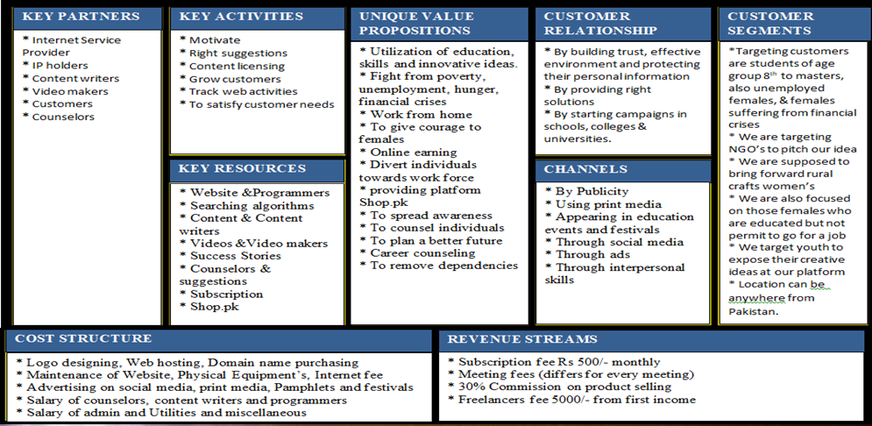
Business Model Canvas of Khudmukhtar Pakistan Consulting Service

Slide 10

Slogan:
Start earning through Working
Marketing Plan
Of Khudmukhtar Pakistan Consulting Service

Slide 11

Marketing Plan
Marketing plan approaches
Summarize
Plan # 01
Plan # 02
Plan # 03
Plan # 04
We will promote KPCS verily so that every single Pakistani be aware of KPCS and get benefits
PROMOTING THROUGH EARLYVANGELISTS
TO REACH SCHOOLS NEAR FROM HOME FOR PROMOTING KPCS.
TO PROMOTE THROUGH SOCIAL MEDIA
TO APPEAR IN FESTIVALS FOR PROMOTING KPCS

Slide 12

Slogan:
Start earning through Working
Financial Plan
Of Khudmukhtar Pakistan Consulting Service

Slide 13



Financial Plan
Hit Investors for fund raising
Take donations
Hit NGO’s for getting
project
Try to take donations from upper class community of Pakistan
We target investors to get fund raising
We target NGO’s to adopt KPCS as their project.

Slide 14
THANK YOU
Turn your problems into opportunities

